Slide 1
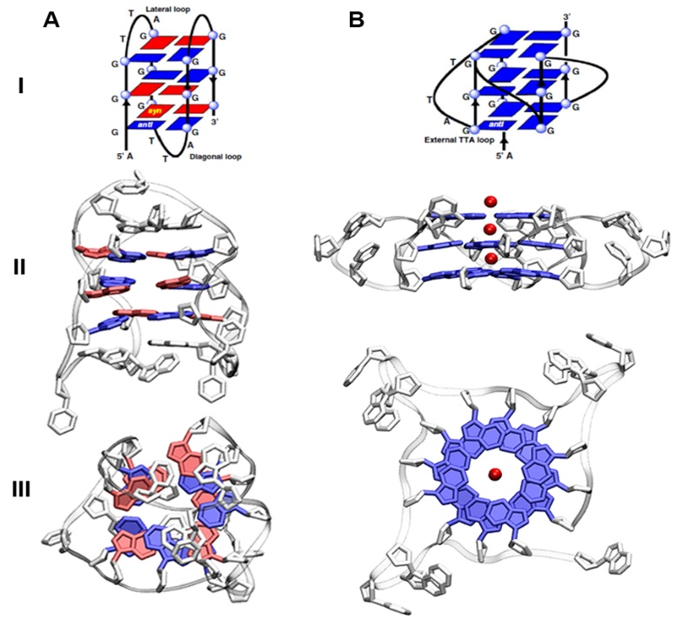




Forme non canoniche di DNA come target antitumorale: una ricerca al confine tra la Fisica e la Biologia
Lucia Comez
Alessandro Paciaroni
Dipartimento di fisica e geologia Perugia (ITALY)
& Consiglio Nazionale delle Ricerche
Caffé Scientifico, 27 novembre 2019

Slide 2
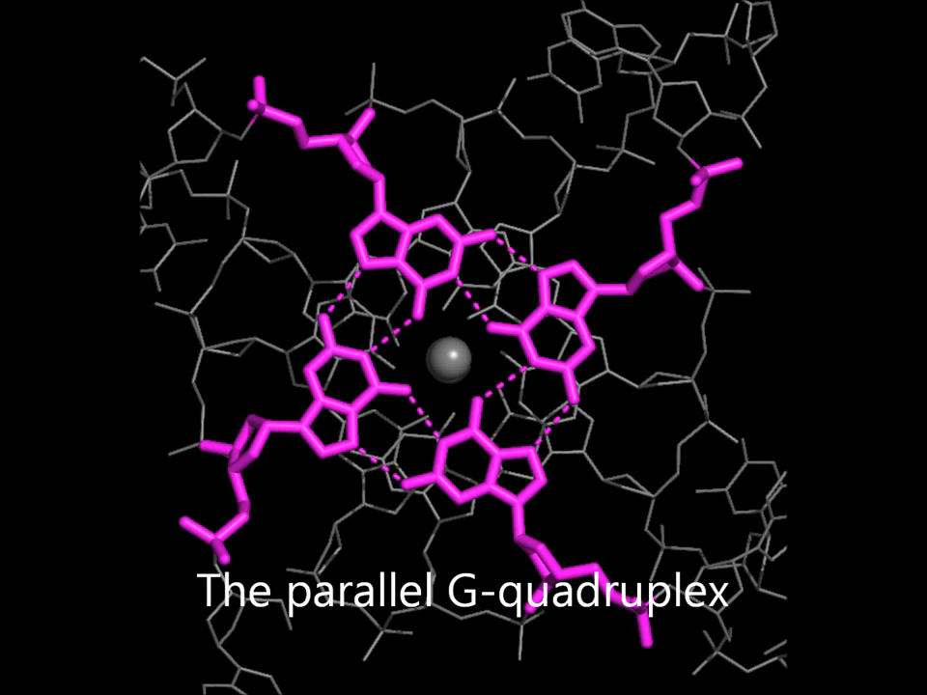
Caffé Scientifico, 27 novembre 2019
2

Slide 3
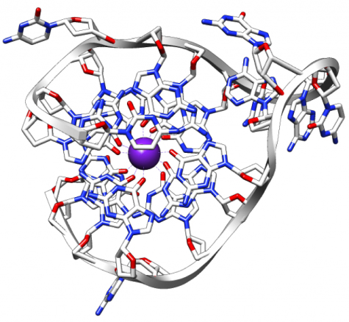
Outline of the lecture
• A short introduction to G-quadruplexes (G4)
• Biomedicine and nano-technology aspects related to G4
• Our system: Tel22
• Results from CD spectroscopy
• Results from UVRR spectroscopy
• Results from SAXS & SANS
• The emerging multi-messanger picture
Caffé Scientifico, 27 novembre 2019
3

Slide 4
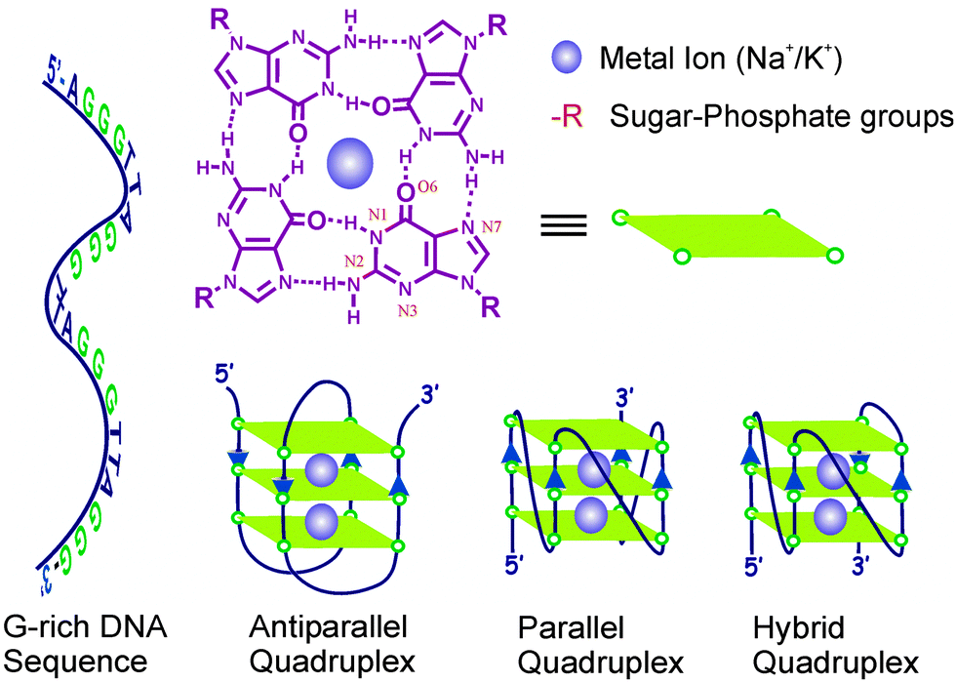
Introducing DNA G-quadruplex
Caffé Scientifico, 27 novembre 2019
4

Slide 5
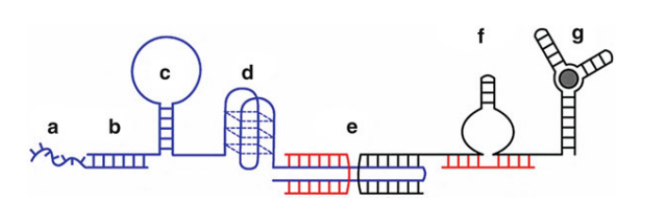
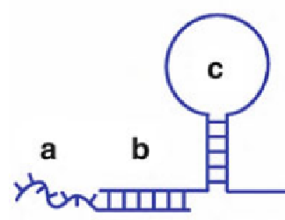
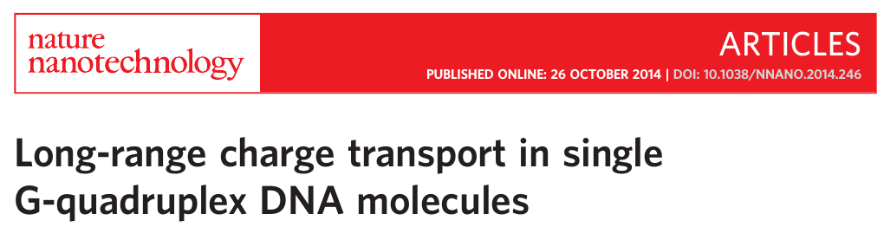
G4 nanotechnology
Functional DNA nanostructures for biosensing, nanoplasmonics, nanorobotics
Different Structural Motifs of DNA
G4 in DNA in nanoconductors
Caffé Scientifico, 27 novembre 2019
5

Slide 6
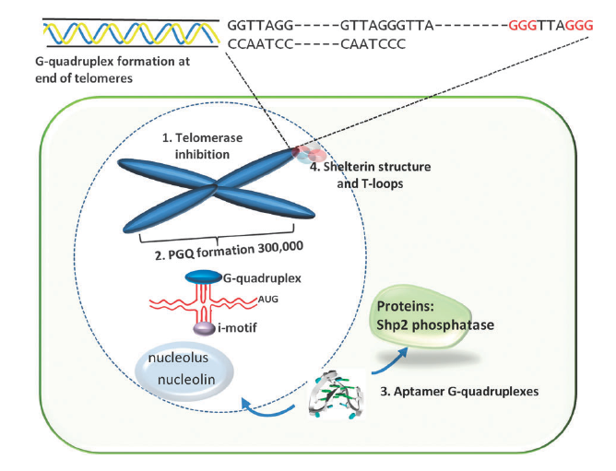
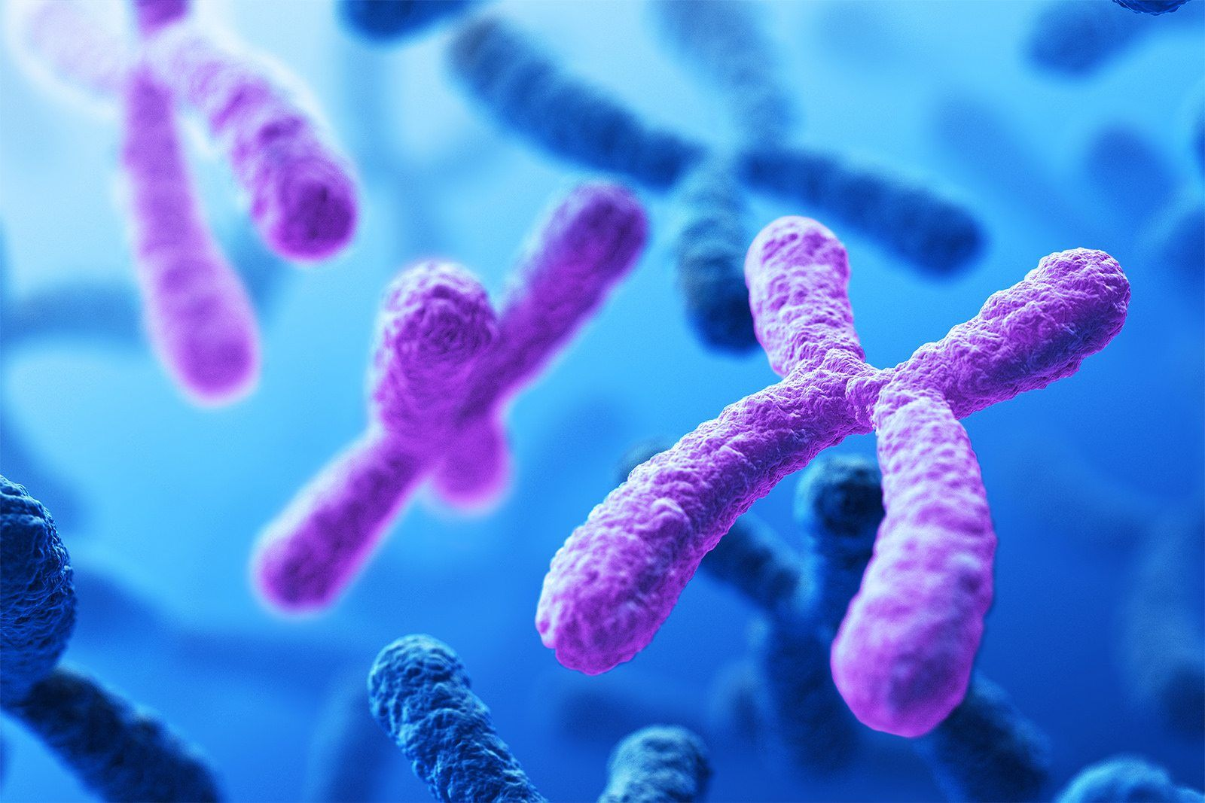
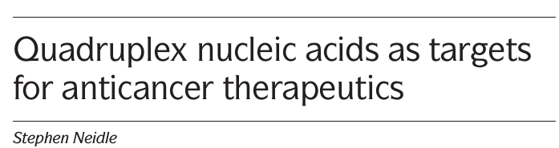

G4 for cancer therapy
I) No hybridization of telomerase to DNA single strand in telomere
II) No transcription of oncogenes
Caffé Scientifico, 27 novembre 2019
6

Slide 7
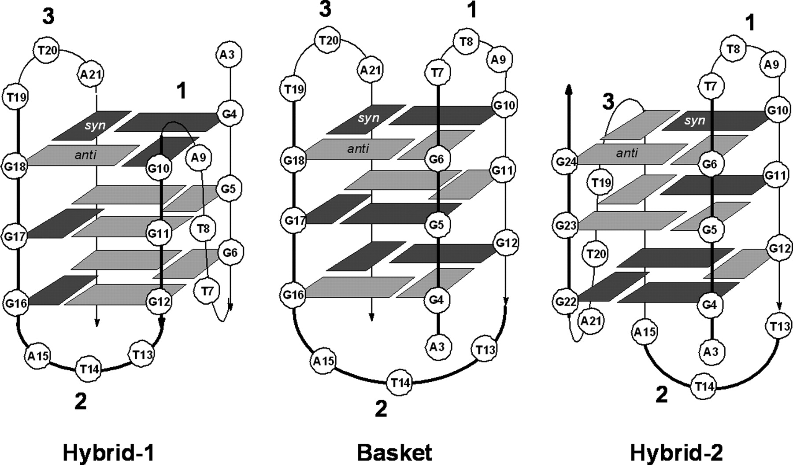
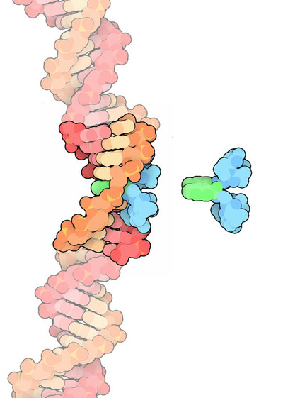
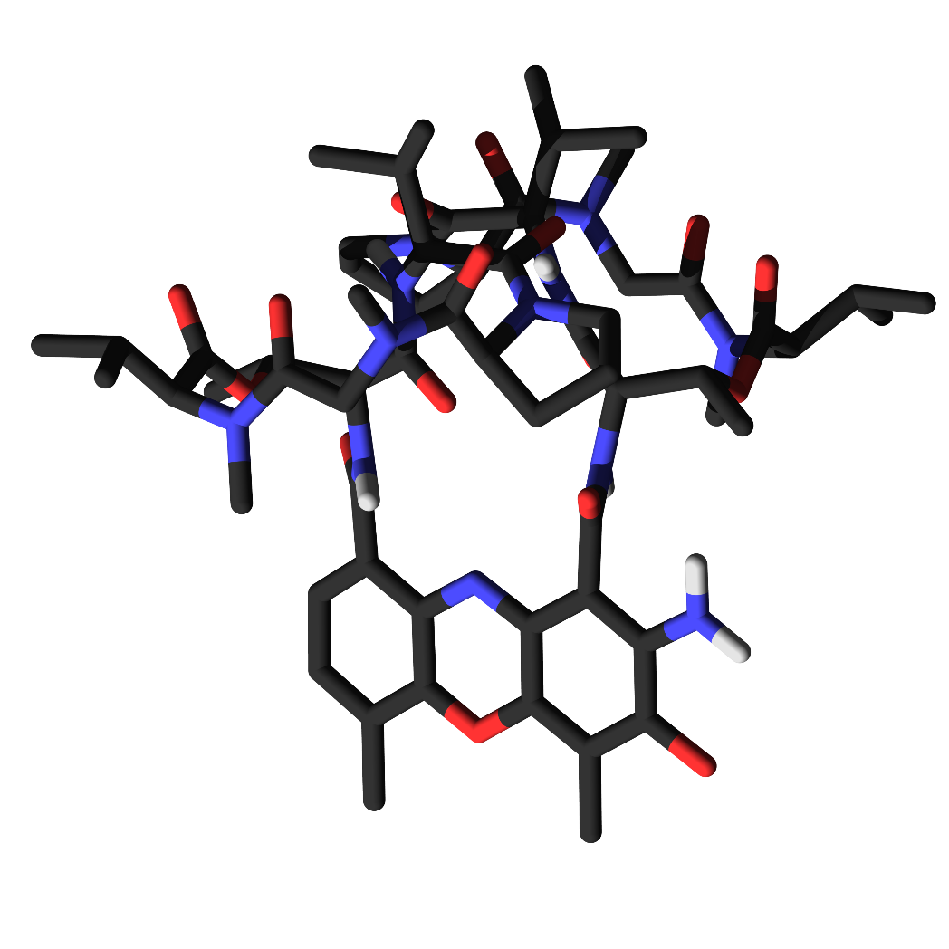
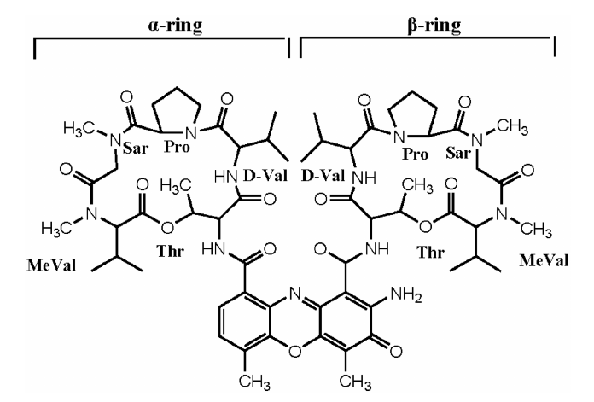
The system we studied
150 mM KCl
G4 = AG₃(T₂AG₃)₃
Tel22
Act D
Caffé Scientifico, 27 novembre 2019
7

Slide 8
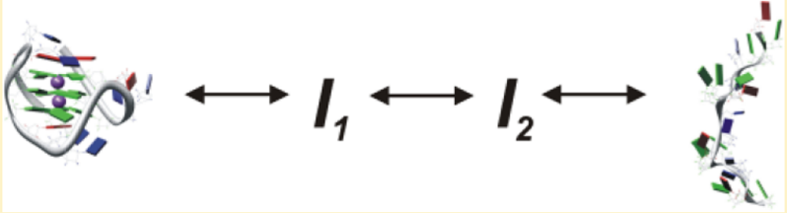
Polymorhphism of G4
Resource (versatility) and issue (drugs)
Structural and thermodynamic properties of G4 and G4-complex need to be properly characterized.
Two-state or multistate denaturation transition?
?
Caffé Scientifico, 27 novembre 2019
8

Slide 9
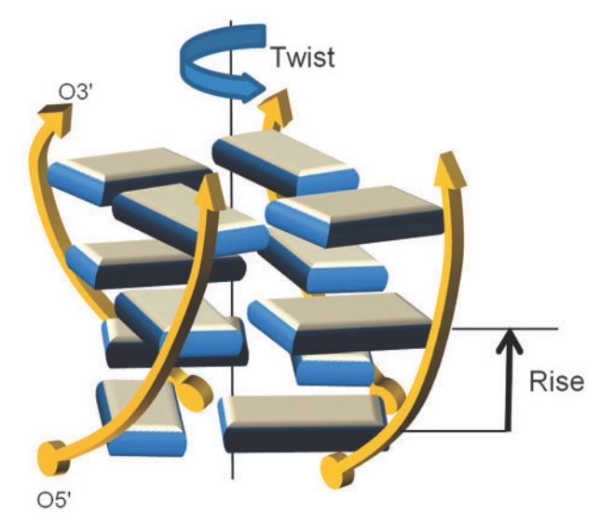
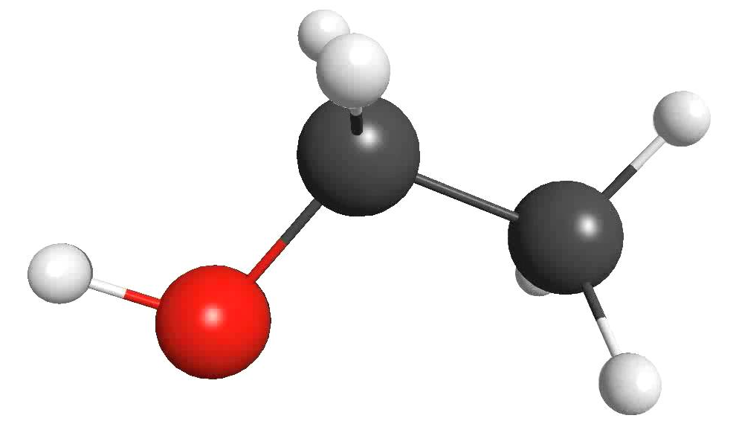
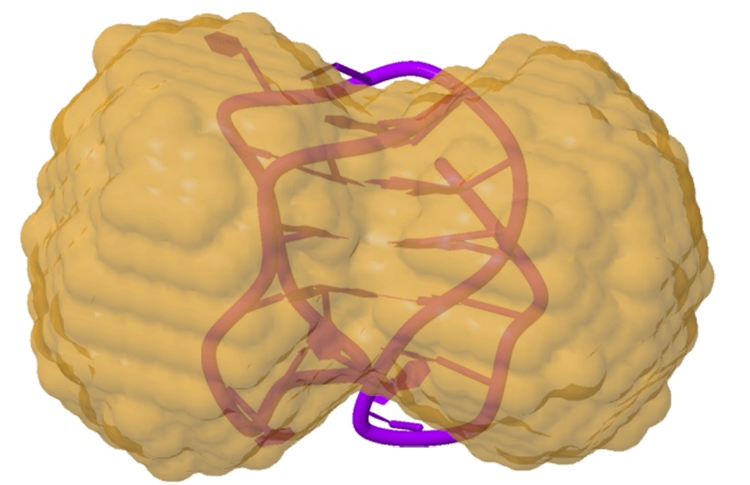
Complementary techniques
UV RR
-Vibrations
-Stacking
CD
-Conformation
-Secondary structure
SAS
-Size
-Shape
-Low-res models
Information on wide dimensional landscape
Dimension
Caffé Scientifico, 27 novembre 2019
9

Slide 10


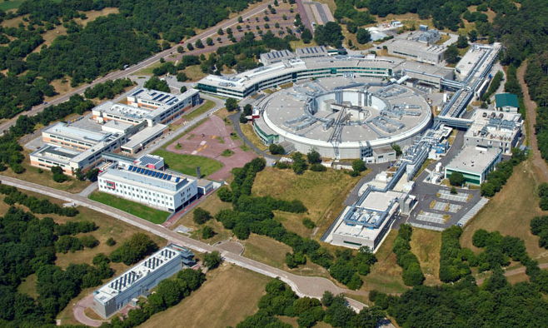
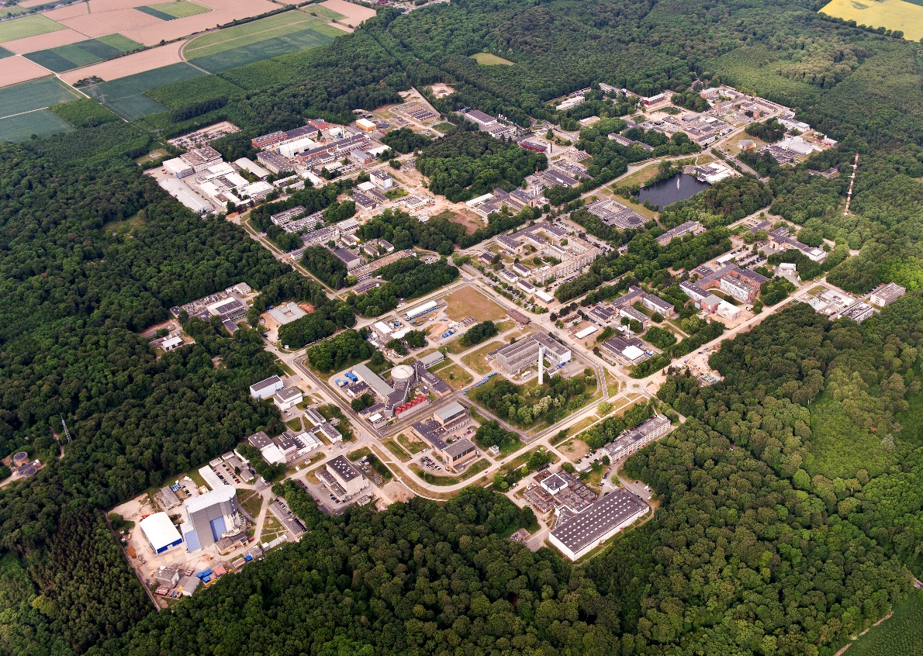
International experimental sessions
UVRR measurements
SAXS measurements
IUVS beamline
https://www.elettra.trieste.it/it/lightsources/elettra/elettra-beamlines/iuvs/iuvs.html
SAXSPACE
http://www.fz-juelich.de/jcns/
SANS measurements
KWS2, MLZ Neutron for Research
Biologia, 2019
10

Slide 11

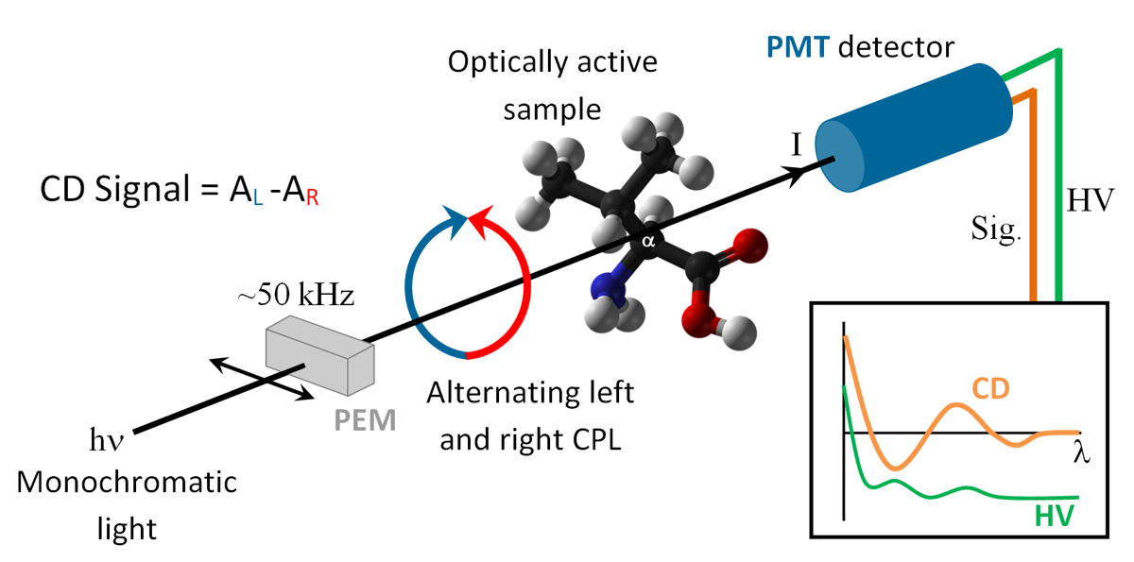
Circular Dichroism spectroscopy
Information on secondary structure of biomolecules
Caffé Scientifico, 27 novembre 2019
11

Slide 12
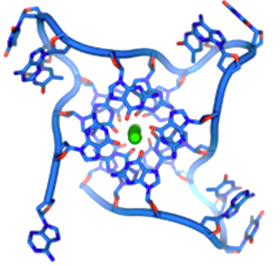
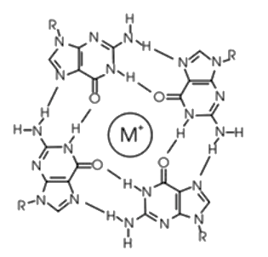
Circular Dichroism spectroscopy
Absorption of right- and left-handed circularly polarized light by chiral molecules differs and the difference is called CD.
Caffé Scientifico, 27 novembre 2019
12

Slide 13
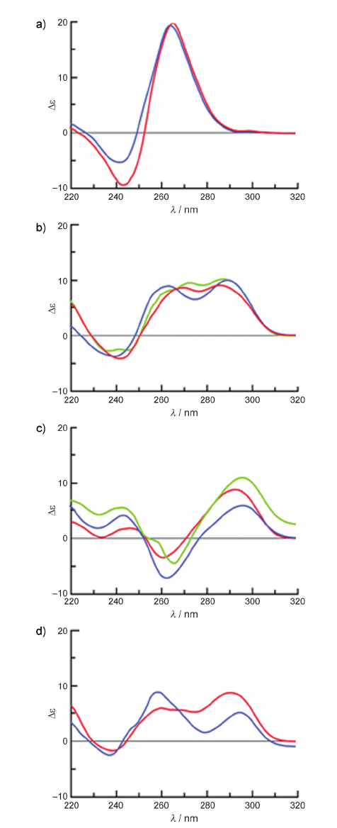
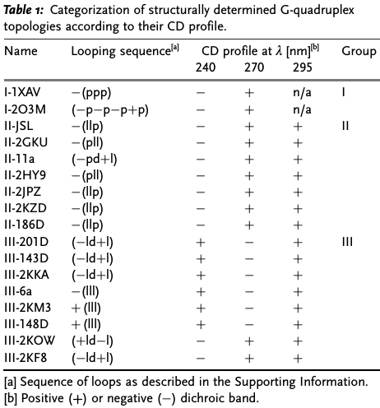
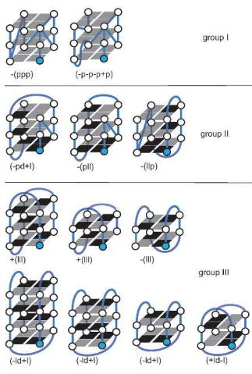
Circular Dichroism spectroscopy
P
AP
H
Karsisiotis Angew. Chem. 2011
Caffé Scientifico, 27 novembre 2019
13

Slide 14
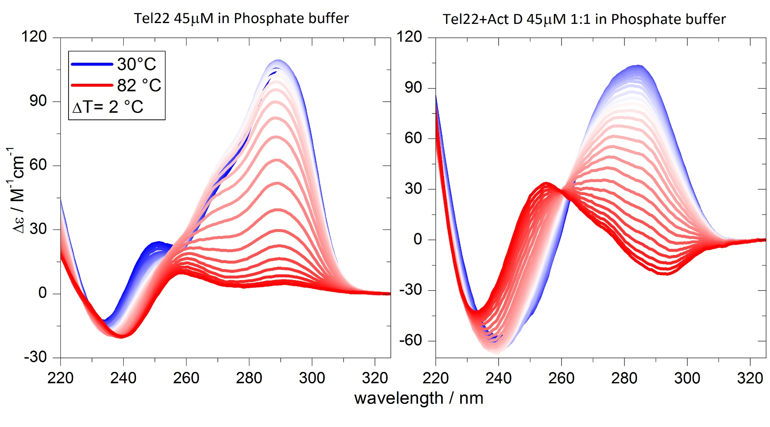
Circular Dichroism spectroscopy:
the path towards melting
A great deal of information. How to exploit it?
Caffé Scientifico, 27 novembre 2019
14

Slide 15
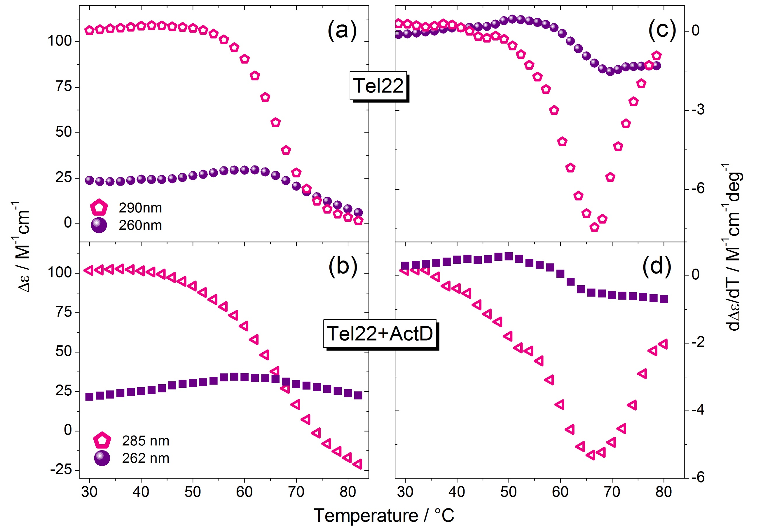
Circular Dichroism spectroscopy:
Melting is not a simple two-state transition
Multistate denaturation process: different inflection points
Caffé Scientifico, 27 novembre 2019
15

Slide 16
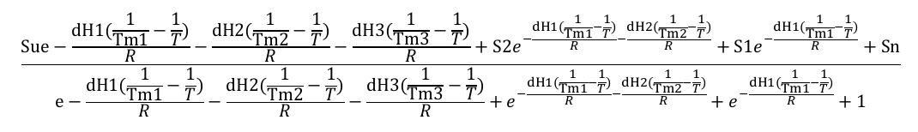
Circular Dichroism spectroscopy:
The path towards melting and the SVD analysis
SVD is a rigorous and model-free analytical tool to evaluate the number of significant spectral species required to account for the changes in CD.
We find that the process that takes place during unfolding is:
F ↔ I1 ↔ I2 ↔ U
Caffé Scientifico, 27 novembre 2019
16

Slide 17
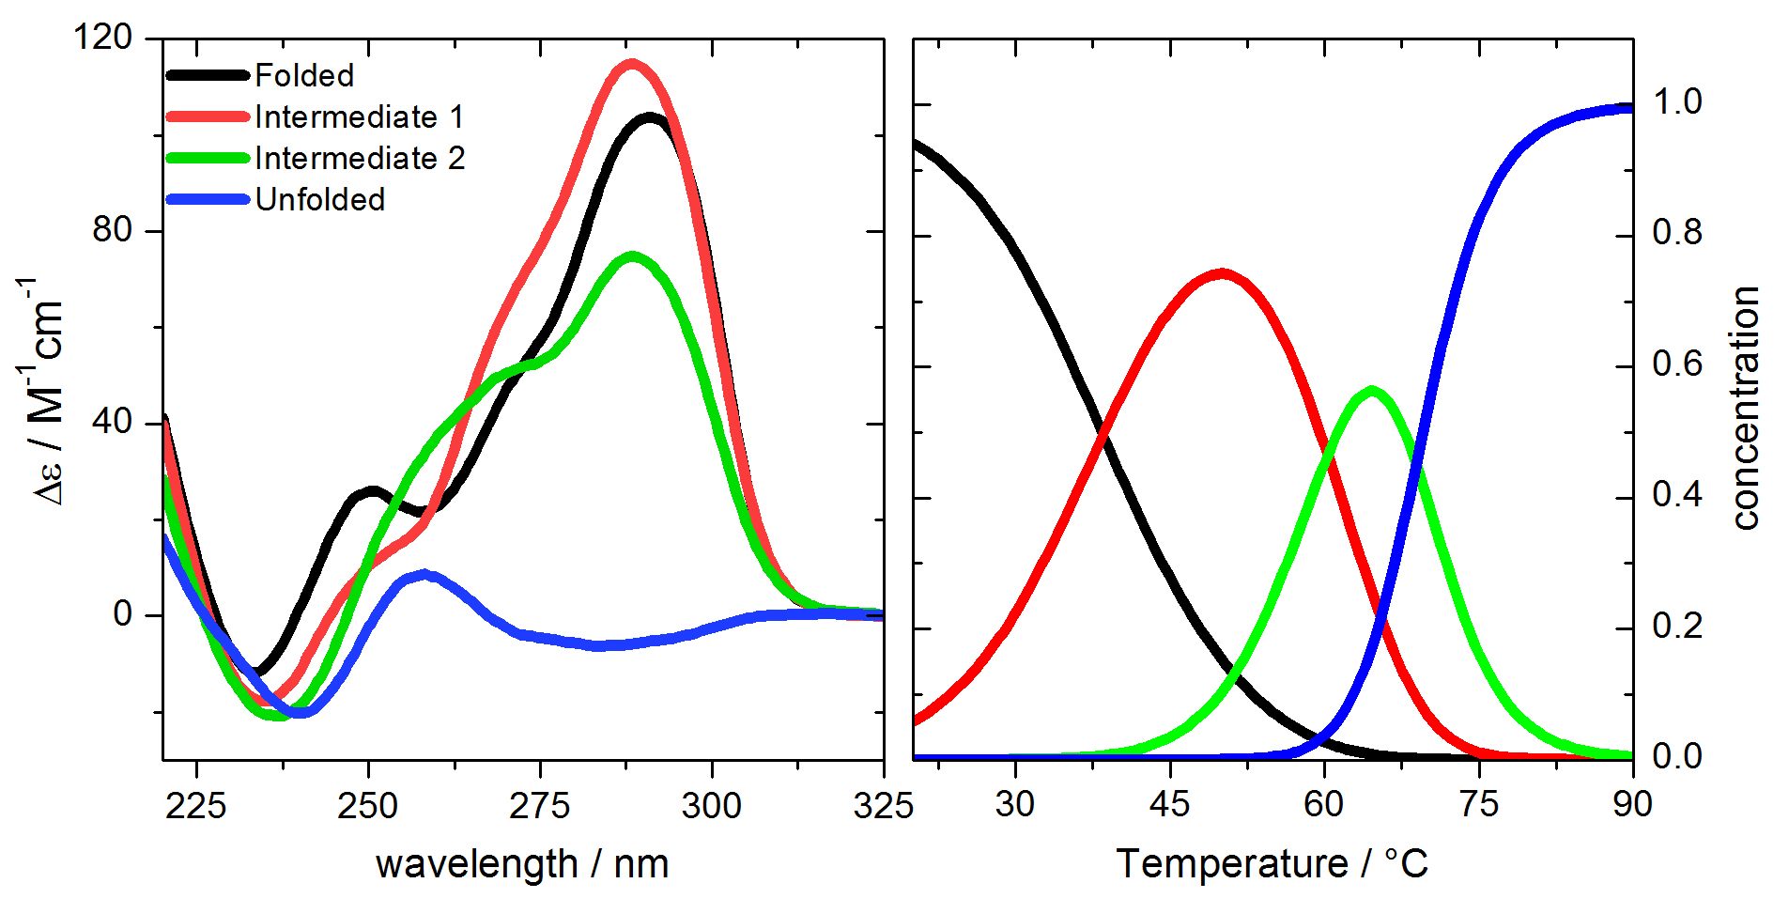
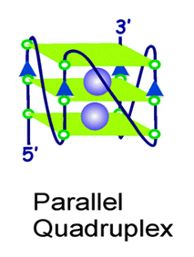
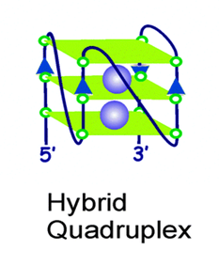
Circular Dichroism spectroscopy:
The path towards melting and the SVD analysis
Calculated spectra and concentration of species from SVD analysis of Tel22
H+P
H+P
Persistence of the hybrid and parallel structures,
even though pre-melting transitions are visible.
Caffé Scientifico, 27 novembre 2019
17

Slide 18
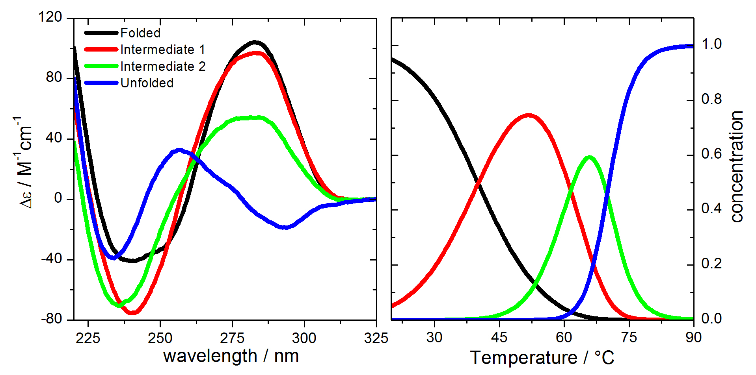
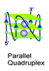
Circular Dichroism spectroscopy:
The path towards melting and the SVD analysis
Calculated spectra and concentration of species from SVD analysis of complex
P
P+dGdG
Increasingly populated parallel conformation in intermediate and unfolded states
Caffé Scientifico, 27 novembre 2019
18

Slide 19
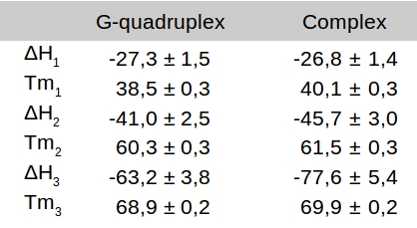
Circular Dichroism spectroscopy:
The path towards melting and the SVD analysis
From a thermodynamic point of view, the results indicate that the COMPLEX is SLIGHTLY STABILIZED by the DRUG.
Our values are larger than those in Gray et al. JACS 2012 , that
are performed at higher K+ concentration
Caffé Scientifico, 27 novembre 2019
19

Slide 20

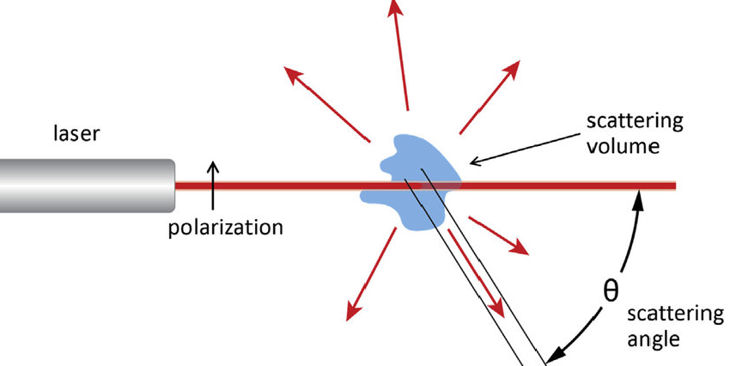
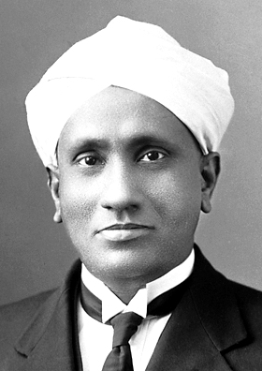
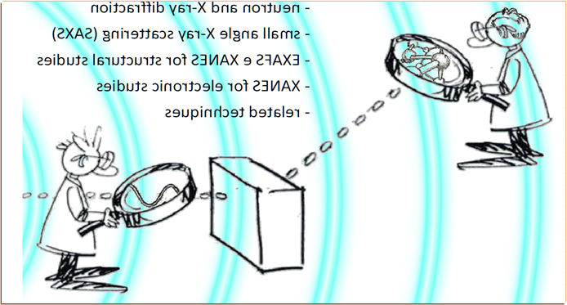
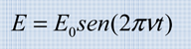
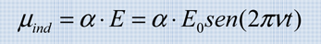
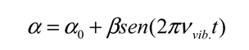
Raman spectroscopy:
The Nobel Prize in Physics 1930 was awarded to Sir Chandrasekhara Venkata Raman "for his work on the scattering of light and for the discovery of the effect named after him."
Caffé Scientifico, 27 novembre 2019
20

Slide 21
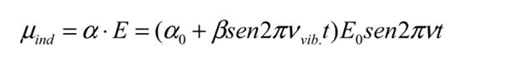
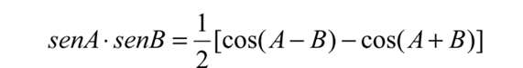
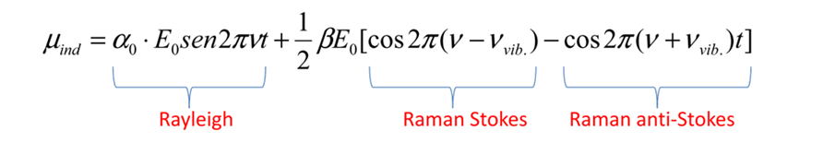
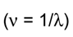
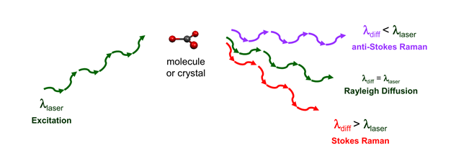
Raman spectroscopy:
Raman bands arise from changes in the molecular polarizability during the vibrations
The difference in frequency (energy) between incident and diffuse photons inelastically corresponds to the difference in frequency between the rotational or vibrational or electronic energy levels of the diffusing molecule.
Caffé Scientifico, 27 novembre 2019
21

Slide 22

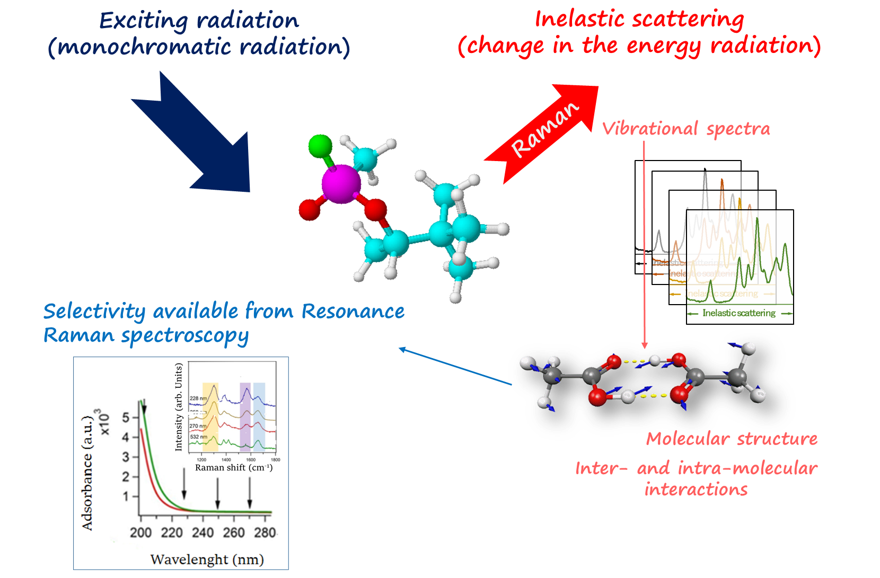
UVRR spectroscopy:
Experiments @ IUVS (Elettra)
Caffé Scientifico, 27 novembre 2019
22

Slide 23
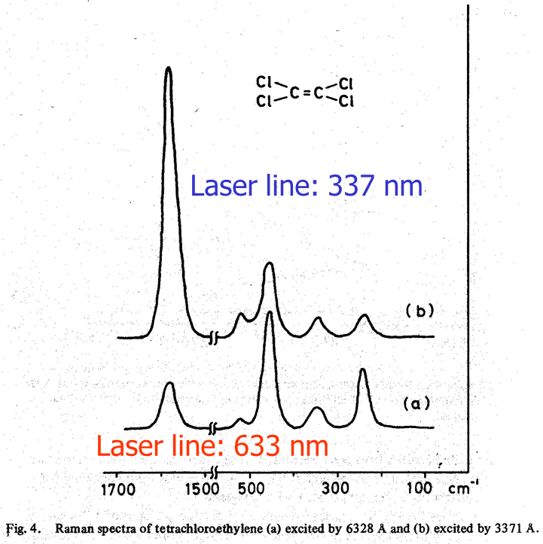
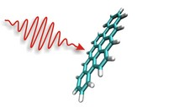
Raman spectroscopy:
Raman scattering intensities of totally symmetric vibrations of the molecular moiety involved in the electronic transition are enhanced by a factor of 10² to 10⁶
π-π* electronic transition at 197 nm
λ_{exc}
High sensitivity:
components at low concentrations can now be detected and analyzed
Specificity: The Raman modes associated to specific parts of the molecule is selectively enhanced in the spectra
Ref:“Advances in Raman spectroscopy-Vol. 1”, edited by J. P. Mathieu
Caffé Scientifico, 27 novembre 2019
23

Slide 24
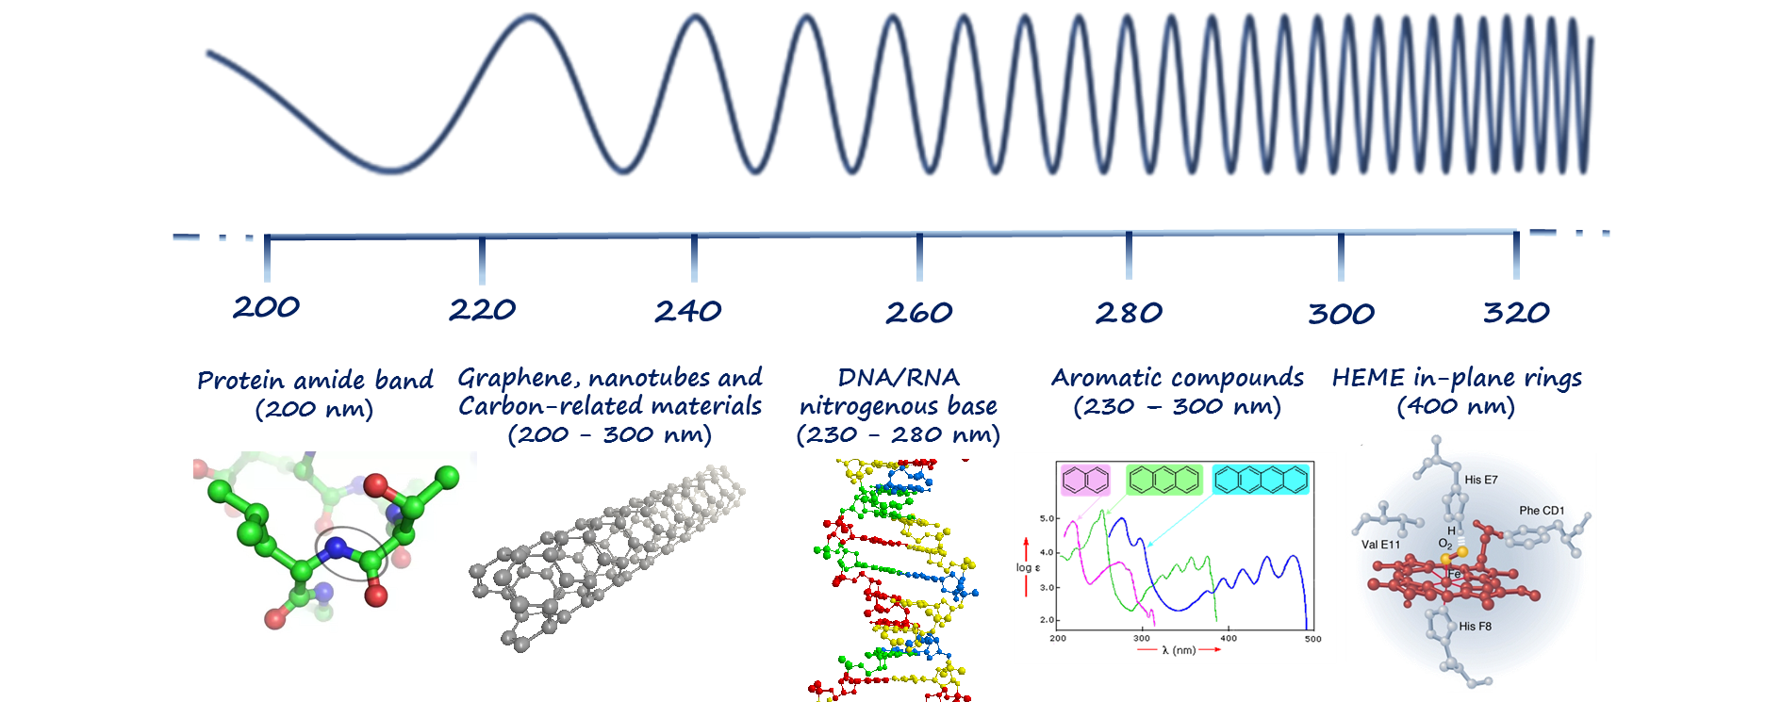
UVRR spectroscopy:
Experiments @ IUVS (Elettra)
UV Resonant Raman landscape
Caffé Scientifico, 27 novembre 2019
24

Slide 25

UVRR spectroscopy:
Experiments @ IUVS (Elettra)
λ_{exc}=266 nm
G4-> The purine (A,G) and pyrimidine (C,T) transitions are π-π* in nature, and are expected to produce Raman resonant.
In particular, the bands in the region of 1150-1600 cm⁻¹ are originated primarily from in-plane stretching vibrations of conjugated CC, CN and CO double bonds of the base residues
S.P.A Fodor, R.P. Rava, T.R. Hays, T.G. Spiro, Ultraviolet Resonance Raman Spectroscopy of the Nucleotides with 266-, 240-, 218-, and 200-nm Pulsed Laser Excitation, J. Am. Chem. Soc. 107 (1985) 1520-1529.
Caffé Scientifico, 27 novembre 2019
25

Slide 26



UVRR spectroscopy:
Experiments @ IUVS (Elettra)
UVRR pros:
1) Selectivity to vibrations of DNA nucleobasis.
2) At λ_{exc}=250 nm the main bands come from Guanine
3) Low concentrations (comparable to CD, i.e. 40 μMol)
4) The solvent contribution can be easily subtracted
Tel22
G
Tel22+ActD
A+G
A+G
Caffé Scientifico, 27 novembre 2019
26

Slide 27




UVRR spectroscopy:
Experiments @ IUVS (Elettra)
Hyperchromic effect -> Guanine stacking.
Melting and complexation -> stacking.
Melted complex comparable to folded G4.
THERE IS RESIDUAL STACKING ALSO AT HIGH-T!!!
Caffé Scientifico, 27 novembre 2019
27

Slide 28



UVRR spectroscopy:
Intensity of selected bands
First evidence of unstacking in G4 upon melting by UVRR
Caffé Scientifico, 27 novembre 2019
28

Slide 29



UVRR spectroscopy:
Raman shift of selected bands
Band II clearly downshifts to ~1574 cm⁻¹ upon unfolding, due to the substitution of inter-guanine with guanine-water HB.
Guanine
Hoogsteen HB
II) Sensitive to HB at exocyclic dG-N2H donor site of guanine
III) Related to NH2 scissoring mode
Caffé Scientifico, 27 novembre 2019
29

Slide 30





SAS experiments:
Interference of waves
Caffé Scientifico, 27 novembre 2019
30

Slide 31

SAS experiments:
Layout of small angle scattering experiments
Caffé Scientifico, 27 novembre 2019
31

Slide 32

SAXS experiments:
FZ Juelich – Kratky camera
Unfolding: enlargement of Tel22
Unfolding: Tel22+ActD compact
Caffé Scientifico, 27 novembre 2019
32

Slide 33


SAXS experiments:
Pair distribution function
$$p\left(r\right)=\frac{r^{2}}{2π^{2}}\int_{0}^{∞}{I(q)q^{2}\frac{\sin{qr}}{qr}dq}$$
Caffé Scientifico, 27 novembre 2019
33

Slide 34


SAXS experiments:
Radius of gyration
Sim et al. PRE 2012, A₀=3.Å, ν=0.6
Almost self-avoiding random walk polynucleotide chain
$$R_{g}=\sqrt{\frac{3}{q^{2}}\ln\left(\frac{I(0)}{I(q)}\right)}$$
R_{g}=A₀ N^{ν}
Yuan et al. PRL 2008
DNA duplex Rg=11.5Å
Caffé Scientifico, 27 novembre 2019
34

Slide 35

SANS experiments:
Form factor
Drug-driven dimerization stabilizing Tel22
Caffé Scientifico, 27 novembre 2019
35

Slide 36



Our picture of Tel22 melting
Caffé Scientifico, 27 novembre 2019
36

Slide 37


Our picture of Tel22+ActD melting
Caffé Scientifico, 27 novembre 2019
37

Slide 38


Our integrated picture
- F ↔ I1 ↔ I2 ↔ U
- I1 and I2 hybrid/antip. states for Tel22
- U mostly parallel for complex
CD spectroscopy
- Drug is stacked upon G-tetrad
Guanine basis in the U state of complex show persistent stacking
UVRR spectroscopy
- U state of Tel22 is random coil-like
- U state of complex is much more compact than U state of Tel22, consistent with DNA duplex, drug-driven dimerization
SAS
Caffé Scientifico, 27 novembre 2019
38

Slide 39
Conclusions
Act D stacks on top of G-tetrads.
Act D strongly perturbs intermediate and unfolded states.
Act D acts like a trap to metastable conformers that are probably visited during G4 folding.
Compact structure for an unfolded quadruplex observed for the first time.
Evidence of drug-driven dimerization and sandwich structure
Integrated multi-technique approach is necessary
Caffé Scientifico, 27 novembre 2019
39

Slide 40


UNIPG
F. Bianchi
C. Petrillo
F. Sacchetti
ELETTRA
B. Rossi
F. D'Amico
A. Gessini
C. Masciovecchio
FZJ
M. Longo
N. Violini
R. Biehl
A. Radulescu
RUB
Funds from:
F. Sebastiani
&
Italian Council of Research (CNR)
IOM start-up project
Caffé Scientifico, 27 novembre 2019
40

Slide 41

Published on NUCLEIC ACIDS RESEARCH
https://www.ceric-eric.eu/2018/11/21/press-release-a-hug-against-cancer/
Annual Report MLZ
Elettra Highlight
Ceric Annual Report
TEF channel: Speciale Università
Caffé Scientifico, 27 novembre 2019
41

Slide 42
Thank You
Caffé Scientifico, 27 novembre 2019
42

Slide 43

Caffé Scientifico, 27 novembre 2019
43

